Slide 1
Vehicle In and Out Maintain System

Slide 2
Problem Statement
Watchman has to maintain the register to get the detail of all vehicle.
It is difficult for them to maintain it.
Our proposed system is the solution for them as user just need to maintain his account and his vehicle detail while entering to the gate of the society/building.
Which gives the detail information related to the user and his entry and exit time.

Slide 3
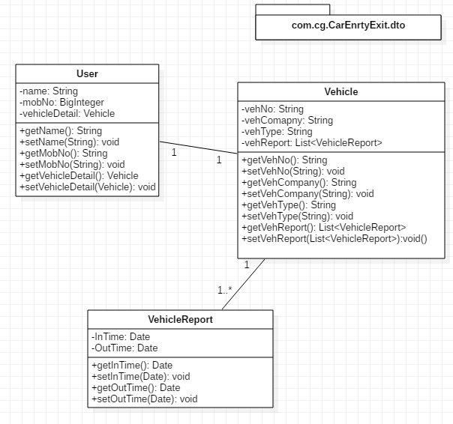
Pojo Classes

Slide 4
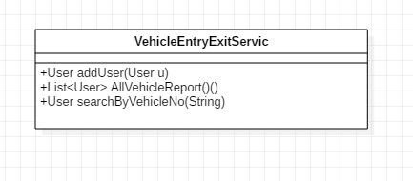
Service Layer

Slide 5
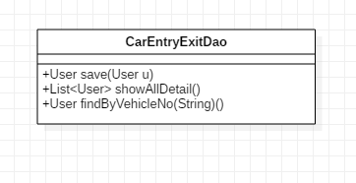
Repository Interface

Slide 6
Thank you!!!

